Slide 1
Linux Filesystem Management
Chapter 4

Slide 2
Objectives
After completing this chapter, you will be able to:
Find files and directories on the filesystem
Understand and create linked files
Explain the function of the Filesystem Hierarchy Standard
Use standard Linux commands to manage files and directories
Modify file and directory ownership
Define and change Linux file and directory permissions
Identify the default permissions created on files and directories
Apply special file and directory permissions
Modify the default access control list (ACL)
View and set filesystem attributes

Slide 3
The Filesystem Hierarchy Standard
Standard set of directories for Linux and UNIX systems
Standard file and subdirectory contents
Simplifies the task of finding specific files
Gives Linux software developers ability to locate files on any Linux system
Create non-distribution–specific software

Slide 4
Managing Files and Directories (1 of 5)
The mkdir (make directory) command: creates new directories
Arguments specify directory’s absolute or relative pathname
The mv (move) command: moves files
Minimum of two arguments
Source file/directory
Target file/directory
Pathnames can be absolute or relative
For multiple files, can use wildcards in pathname
Also used to rename files

Slide 5
Managing Files and Directories (2 of 5)
The cp (copy) command: copies files
Same arguments as the mv command
Also used to make copies of files
To copy a directory full of files, you must tell the cp command that the copy will be recursive
Copies files and subdirectories
Use –r option

Slide 6
Managing Files and Directories (3 of 5)
The target is a file that exists
Both the mv and cp commands warn the user that the target file will be overwritten and will ask whether to continue
A feature of the default configuration in Fedora Linux because the BASH shell contains aliases to the cp and mv commands
To see the aliases present in the current shell, type alias at the prompt

Slide 7
Managing Files and Directories (4 of 5)
Interactive mode: prompts user before overwriting files
–f option (force): overrides interactive mode
The rm (remove) command: removes files
Arguments are a list of files
Can use wildcards
Interactive mode by default
Use -f option to override
The rmdir (remove directory) command: removes directories
Only removes a directory if it contains no files

Slide 8
Managing Files and Directories (5 of 5)
Table 4-2: Common Linux file management command
Command | Description
mkdir | Creates directories
rmdir | Removes empty directories
mv | Moves/renames files and directories
cp | Copies files and directories full of files (with the –r or –R option)
alias | Displays BASH shell aliases
rm | Removes files and directories full of files (with the –r or –R option)
unlink | Removes files

Slide 9
Finding Files (1 of 3)
The locate command: search for files in the Linux directory tree
Looks in a premade indexed database of all files on system
To update the database use the updatedb command
Information returned may not fit on screen
Use with more or less commands

Slide 10
Finding Files (2 of 3)
The find command: recursively search for files starting from a specified directory
Slower than locate command, but more versatile
Format: find <start directory> -criteria <what to find>
If using wildcard metacharacters, ensure that they are interpreted by the find command; place wildcards in quotation marks
To reduce search time, specify subdirectory to be searched

Slide 11
Finding Files (3 of 3)
PATH variable: lists directories on system where executable files are located
Allows executable files to be run without specifying absolute or relative path
The which command: search for an executable file
Searches the PATH variable
If the file is not found, lists the directories that were searched
Alternatives: type command and whereis command

Slide 12
Linking Files (1 of 7)
Files can be linked to one another
Symbolic link (symlink): one file is a pointer or shortcut to another
Hard link: two files share the same data
To better understand how files are linked, you must understand how files are stored on a filesystem
Superblock
Inode table
Data blocks

Slide 13
Linking Files (2 of 7)
Superblock: contains information about the filesystem
Number of inodes and data blocks
Size of each data block
The inode table: consists of several inodes
Each describes a file or directory and contains a unique inode number for identification
The inode stores file size, data block locations, last date modified, permissions, and ownership
Data blocks: data making up contents of a file
Referenced by the inode

Slide 14
Linking Files (3 of 7)
Hard linked files share the same inode and inode number
Must reside on the same filesystem
To create a hard link, use the ln (link) command and specify two arguments
The existing file to hard-link and the target file that will be created as a hard link to the existing file
To remove hard linked files, delete one of the linked files
Reduces the link count for the file

Slide 15
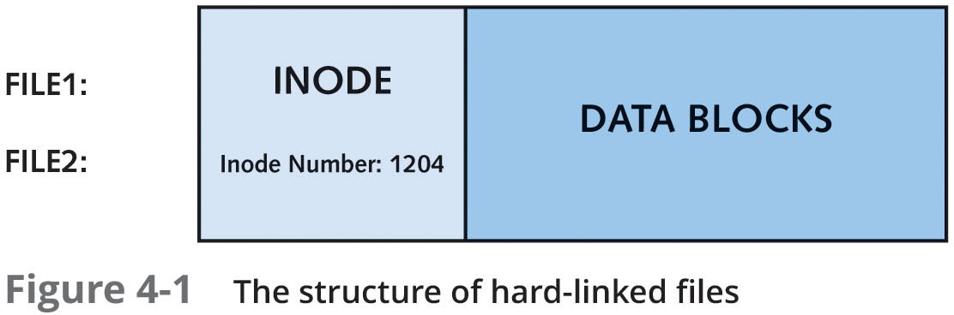
Linking Files (4 of 7)
Figure 4-1: The structure of hard linked files

Slide 16
Linking Files (5 of 7)
Symbolic linked files do not share the same inode and data blocks with their target file
Symbolic linked file is a pointer to the target file
Data blocks in the linked file contain only a pathname to the target file
Editing a symbolic linked file actually edits the target file
If the target file is deleted, symbolic link serves no function

Slide 17
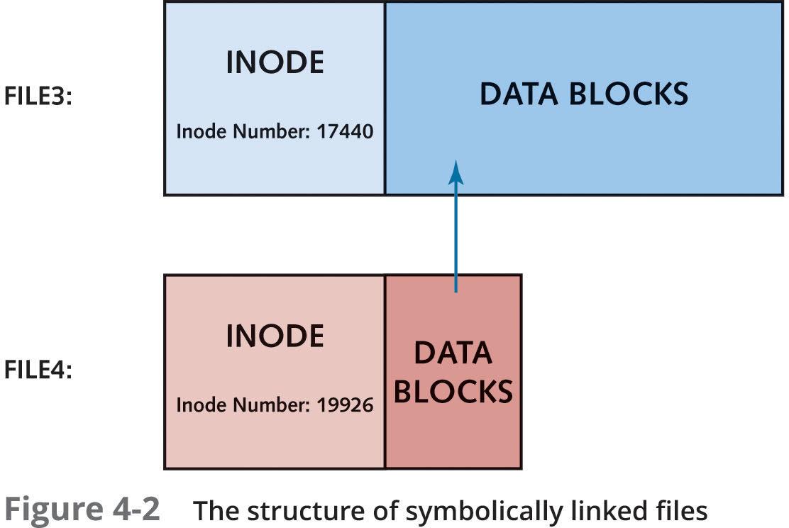
Linking Files (6 of 7)
Figure 4-2: The structure of symbolically linked files

Slide 18
Linking Files (7 of 7)
To create a symbolic link, use the -s option with the ln command
Arguments can be relative or absolute pathnames, as with hard links
Use the ls -l command to view both hard link and symbolic link files
Symbolic links need not reside on the same filesystem as their target

Slide 19
File and Directory Permissions
All users must login with a username and password
Users identified by username and group memberships
Access to resources depends on username and group membership
Must have required permissions

Slide 20
File and Directory Ownership (1 of 2)
During file creation, that user’s name and primary group becomes the owner and group owner of the file
Same for directory creation
The whoami command: views current user name
The groups command: views group memberships and primary group
The touch command: creates an empty file

Slide 21
File and Directory Ownership (2 of 2)
The chown (change owner) command: change ownership of a file or directory
Two arguments
New owner
File or directory to change
Can use –R option to change permissions recursively throughout the directory tree
The chgrp (change group) command: change group owner of a file or directory
Same arguments and options as for chown command

Slide 22
Managing File and Directory Permissions
Mode: inode section that stores permissions
User permissions: owner
Group permissions: group owner
Other permissions: everyone on system
Three regular permissions may be assigned to each user
Read
Write
Execute

Slide 23
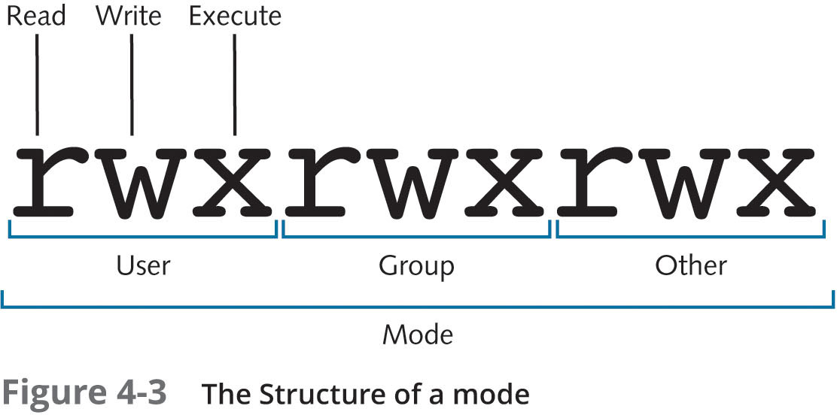
Interpreting the Mode (1 of 2)
Figure 4-3: The structure of a mode

Slide 24
Interpreting the Mode (2 of 2)
User or owner: refers to users with read, write, and execute permission
Other: refers to all users on system
Permissions are not additive
The system assigns the first set of permissions that are matched in the mode order: user, group, other
Linux permission should not be assigned to other only

Slide 25
Interpreting Permissions
Table 4-4 : Linux permissions
Permission | Definition for files | Definition for files
Read | Allows a user to open and read the contents of a file | Allows a user to list the contents of the directory (if the user has also been given execute permission)
Write | Allows a user to open, read, and edit the contents of a file | Allows a user to add or remove files to and from the directory (if the user has also been given execute permission)
Execute | Allows a user to execute the file in memory (if it is a program file or script) | Allows a user to enter the directory and work with directory contents

Slide 26
Changing Permissions (1 of 3)
The chmod (change mode) command: change mode (permissions) of files or directories
Takes two arguments at minimum
Criteria used to change permissions
Filenames to change
If the permissions to be changed are identical for the user, group, and other categories, you can use the “a” character to refer to all categories

Slide 27
Changing Permissions (2 of 3)
Table 4-5: Criteria used within the chmod command
Category | Operation | Permission
u (user) | + (adds a permission) | r (read)
g (group) | - (removes a permission) | w (write)
o (other) | = (makes a permission equal to) | x (execute)
a (all categories)

Slide 28
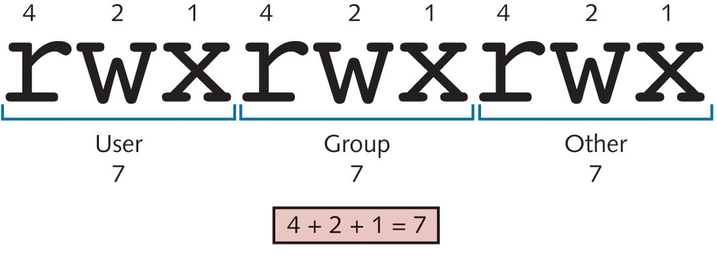
Changing Permissions (3 of 3)
Figure 4-4: Numeric representation of the mode

Slide 29
Default Permissions (1 of 2)
New files are given rw-rw-rw- permissions by default
The umask variable: a special variable that takes away permissions on new files and directories
The umask command: displays the umask
Changing the umask: se a new umask as an argument to the umask command

Slide 30
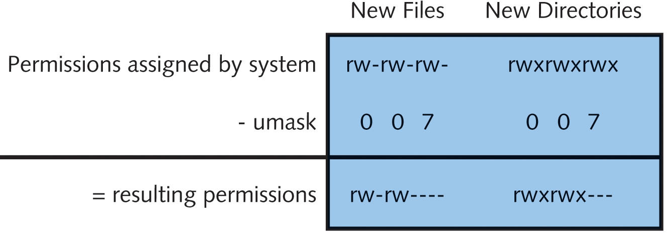
Default Permissions (2 of 2)
Figure 4-6: Performing a umask 007 calculation

Slide 31
Special Permissions
Three more optional special permissions for files and directories
SUID (Set User ID)
SGID (Set Group ID)
Sticky bit

Slide 32
Defining Special Permissions (1 of 3)
If SUID is set on a file, user who executes the file becomes owner of the file during execution (e.g., passwd command)
No special functionality when set on a directory
Only applicable to binary compiled programs
Cannot be used on shell scripts

Slide 33
Defining Special Permissions (2 of 3)
SGID: applicable to files and directories
If set on a file, user who executes the file becomes member of the file’s group during execution
If a user creates a file in a directory with SGID set, the file’s group owner is set to be the directory’s group owner and not the user’s primary group

Slide 34
Defining Special Permissions (3 of 3)
Sticky bit: previously used to lock files in memory
Currently only applicable to directories
Ensures that a user can only delete his/her own files when given write permissions in a directory

Slide 35
Setting Special Permissions (1 of 3)
Special permissions require execute
They mask the execute permission when displayed by the ls –l command
May be set even if file or directory does not have execute permission
Indicating letter in the mode will be capitalized
Add special permissions via chmod command

Slide 36
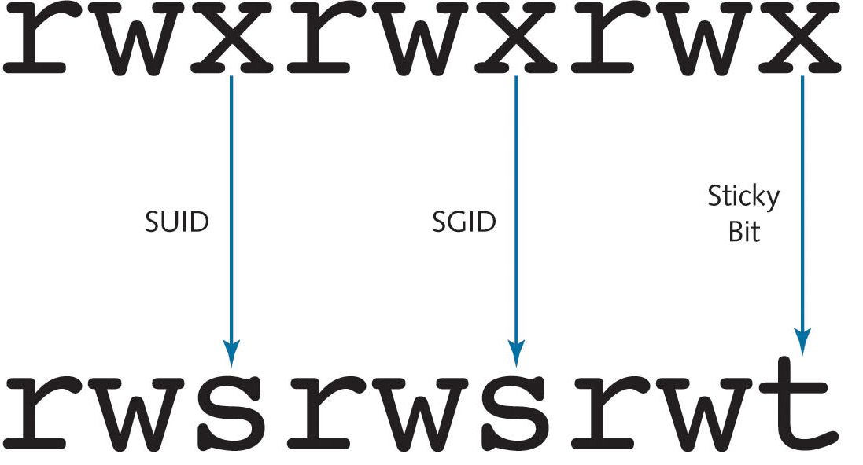
Setting Special Permissions (2 of 3)
Figure 4-7: Representing special permissions in the mode

Slide 37
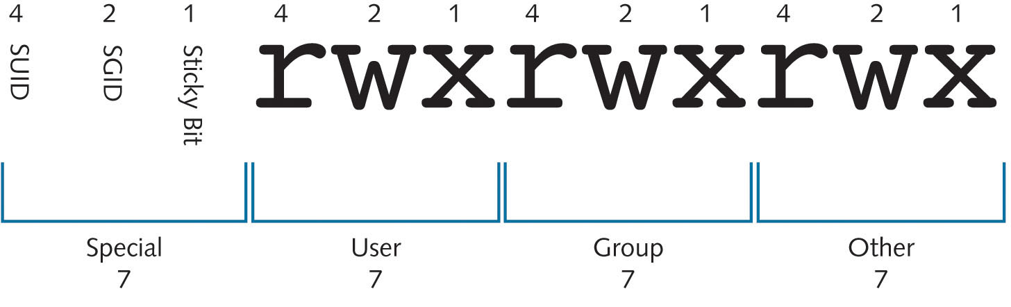
Setting Special Permissions (3 of 3)
Figure 4-9: Numeric representation of regular and special permissions

Slide 38
Setting Custom Permissions in the Access Control List (ACL)
Access control list (ACL): a list of users or groups that you can assign permissions
The setfacl (set file ACL) command: used to modify ACL entries for a particular Linux file or directory
Use the -m option to modify the ACL
Use the -b option to remove all extra ACL assignments on a particular file or directory
The getfacl (get file ACL) command: used to list all additional entries in the ACL

Slide 39
Managing Filesystem Attributes
Linux has file attributes that can be set; work outside Linux permissions and are filesystem-specific
The lsattr (list attributes) command: used to list filesystem attributes
The chattr (change attributes) command: used to add or remove filesystem attributes
Immutable attribute (i): prevents the file from being modified in any way

Slide 40
Summary (1 of 3)
The Linux directory tree obeys the Filesystem Hierarchy Standard
Allows system files to be located in standard directories
Many file management commands exist
Create, change the location of, or remove files
You can find files using different commands
locate: search preindexed database
which: search PATH variable
find: search for file based on criteria

Slide 41
Summary (2 of 3)
Files can be linked two different ways
Symbolic link: a file serves as a pointer to another
Hard links: one file is a linked duplicate of another
Each file and directory has an owner and a group owner
Owner can change permissions and grant ownership
Permissions can be set on the owner of a file, members of the group of the file, and everyone on the system (other)
There are three regular file and directory permissions (read, write, execute) and three special file and directory permissions (SUID, SGID, sticky bit)

Slide 42
Summary (3 of 3)
Permissions can be changed using chmod command
New files and directories receive default permissions
The root user has all permissions to all files and directories on the Linux filesystem
Root user can change the ownership of any file or directory
The default ACL on a file or directory can be modified to include additional users or groups
Filesystem attributes can be set on Linux files to provide low-level functionality such as immutability

